Slide 1
Maximum information entropy methods in landscape ecology
and energy as a uniting factor in modeling
complex landscapes
Erica A. Newman ^{1,2}
¹ School of Natural Resources and the Environment, University of Arizona
² Pacific Wildland Fire Sciences Laboratory, U.S. Forest Service, Seattle WA
Complexity in dynamic and non-hierarchical systems, SFI
March 15, 2018

Slide 2
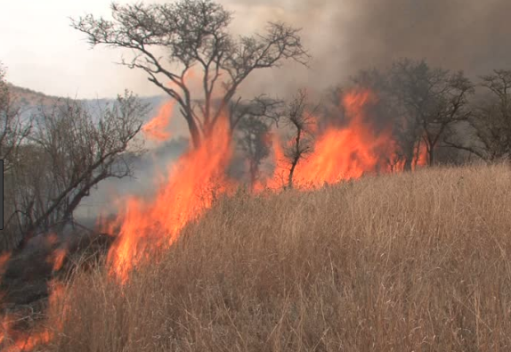
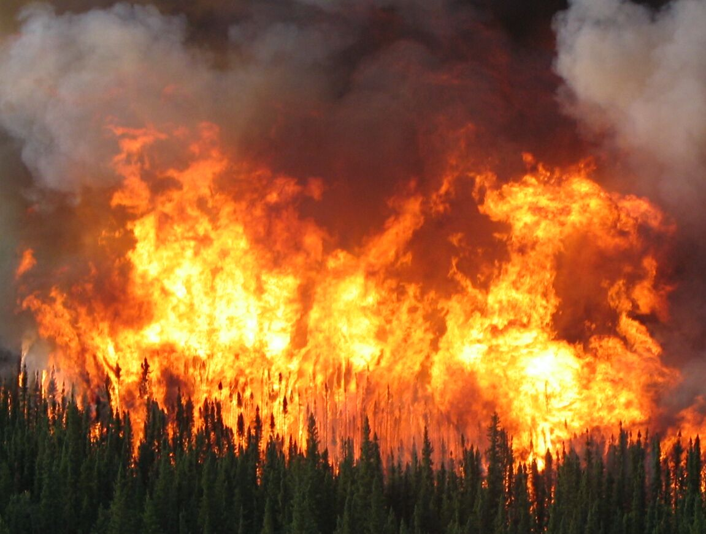
What is a fire regime?

Slide 3
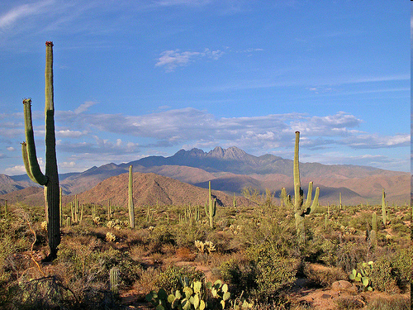
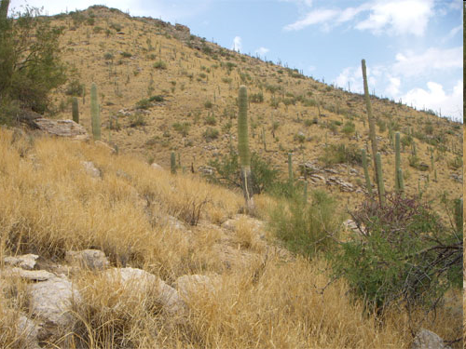
Fire regimes are altered by novel interactions
Sonoran Desert, Arizona, pre- and post Buffelgrass (Cenchrus ciliaris) invasion

Slide 4
Defining “disturbance”
Natural disturbance regimes are defined by:
Type
Expected frequency
Average size
Season
Severity
Interactions with other
disturbance regimes
Anthropogenic disruptions:
Deviate from historic norms in one or more of these categories, and may involve invasive species or emergent diseases

Slide 5
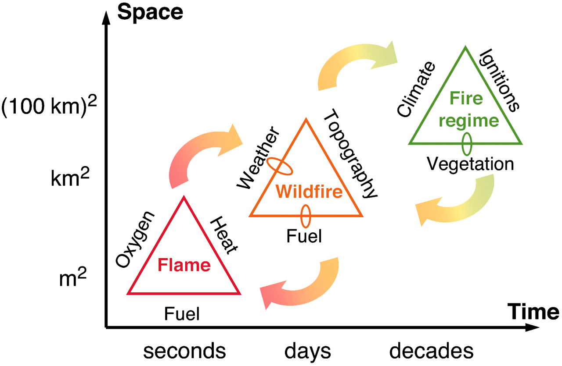
Fire regimes are dynamic and non-hierarchical
Moritz MA et al. (2005) PNAS

Slide 6
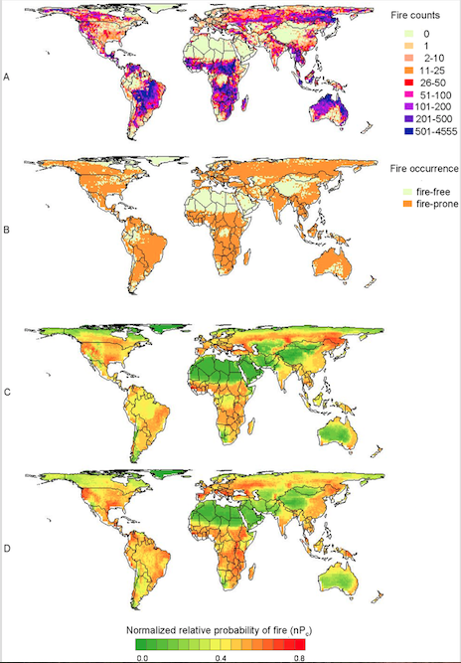
MaxEnt as a spatially
explicit modeling tool
The MaxEnt software can create
“species distribution models” for
wildfire occurrences
The grain-size of input information
influences the resulting model
Krawchuk et al. Global pyrogeography:
the current and future distribution of wildfire.
PloS one 4.4 (2009): e5102.

Slide 7
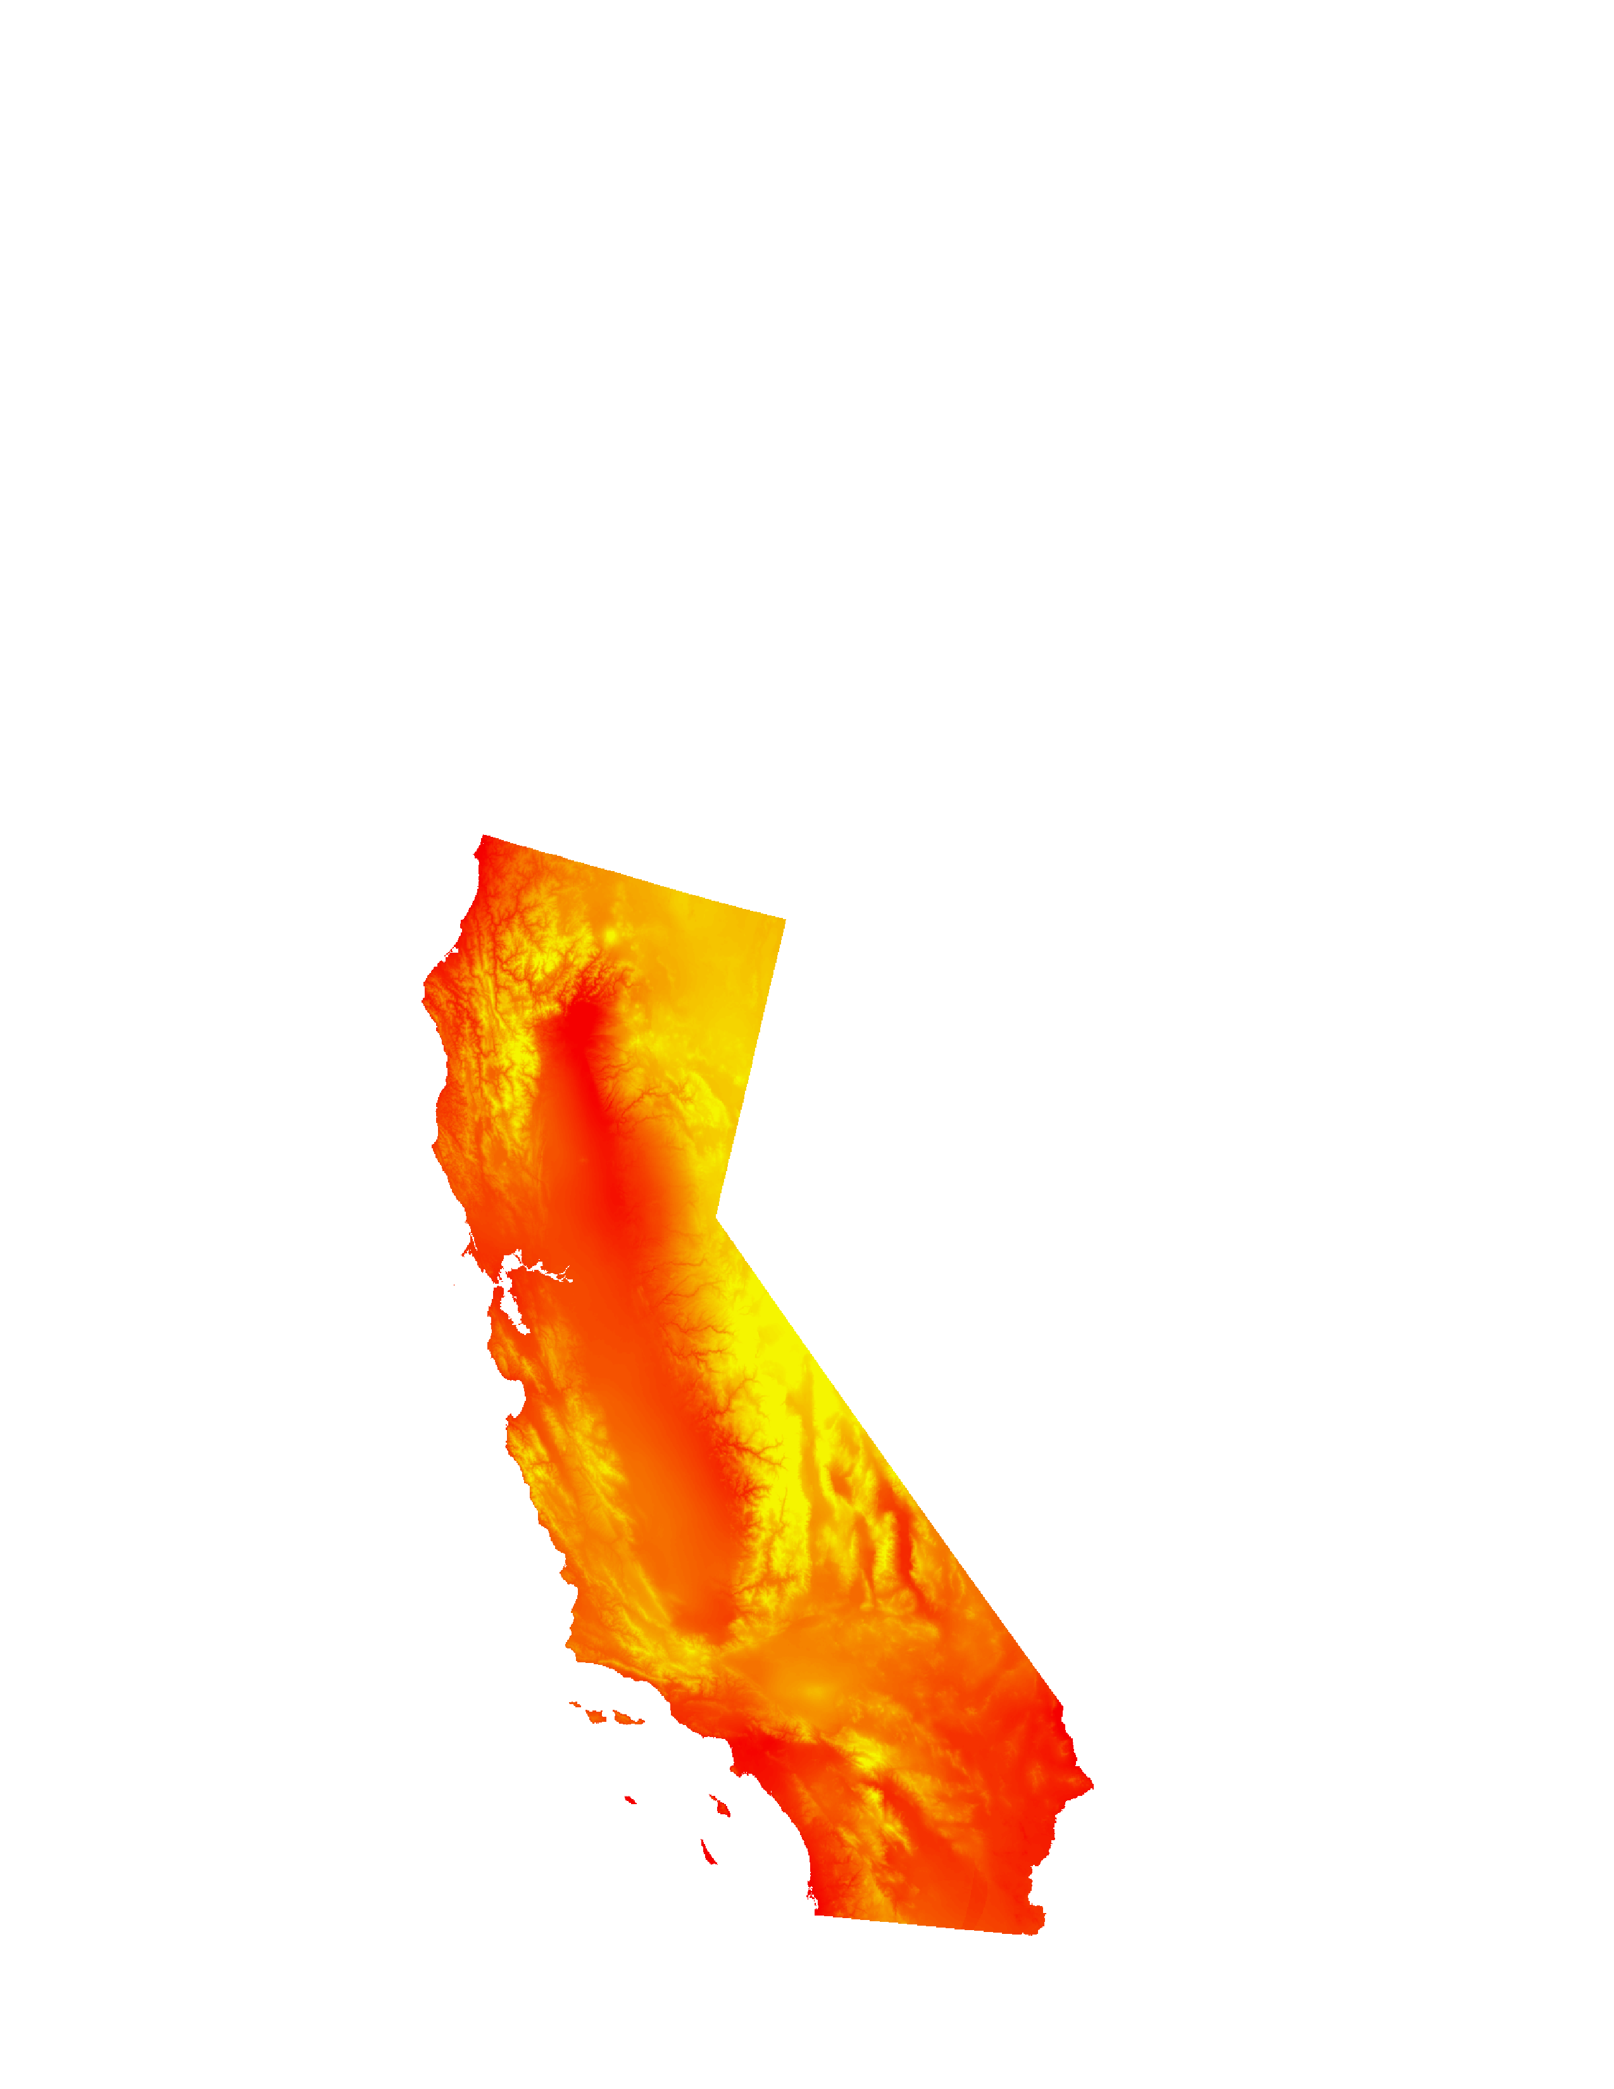
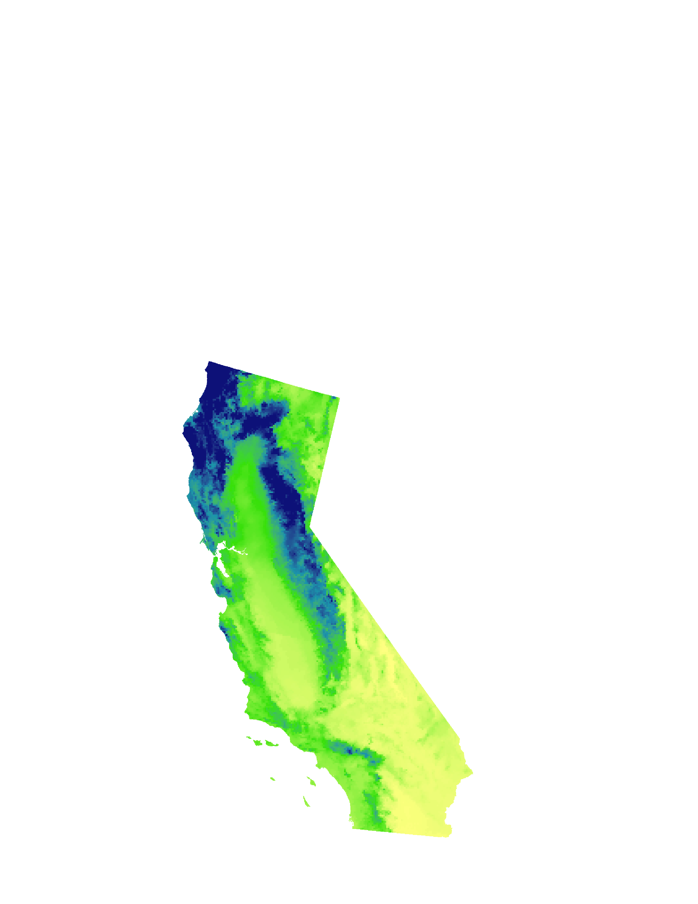

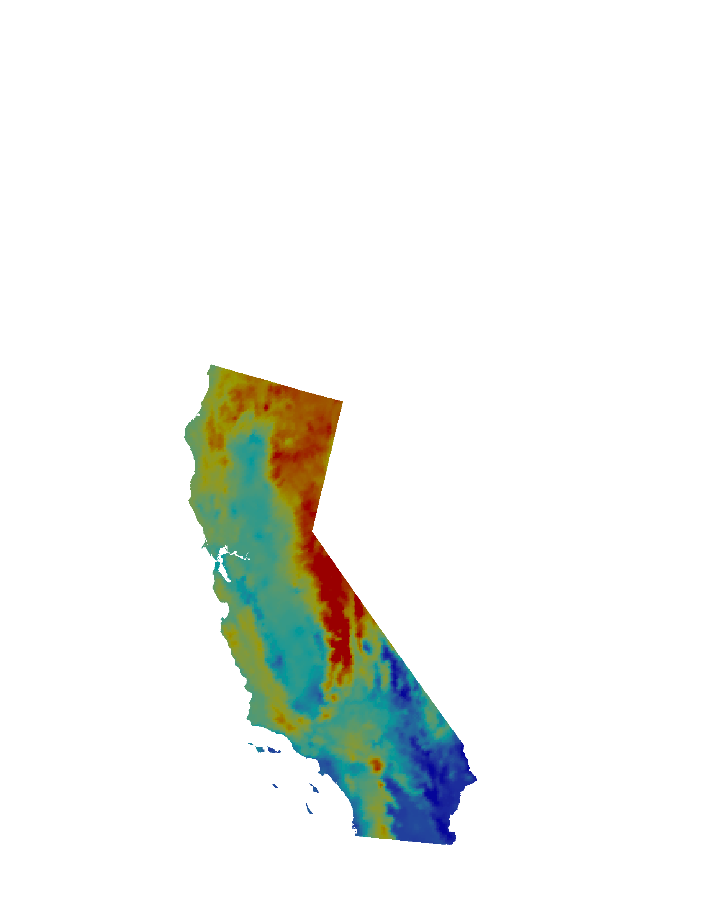
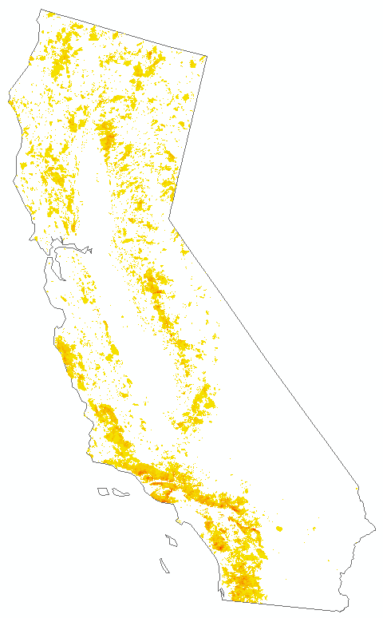
Species distribution modeling of fire in the MaxEnt framework
Fire Presence
and Background
Predictor Variables
=
+
+
+
+ ….
Fire Presence {1,0} =
Max temp +
warmest month
Annual +
precipitation
Absolute humidity +
Elevation + ….
We use the MaxEnt Species Distribution Modeling Tool (SDM) to “infill” baseline
fire probabilities, or to project to a different (spatial or temporal) region with
similar climatic conditions
Sources: PRISM, Daymet, Cal Frap

Slide 8
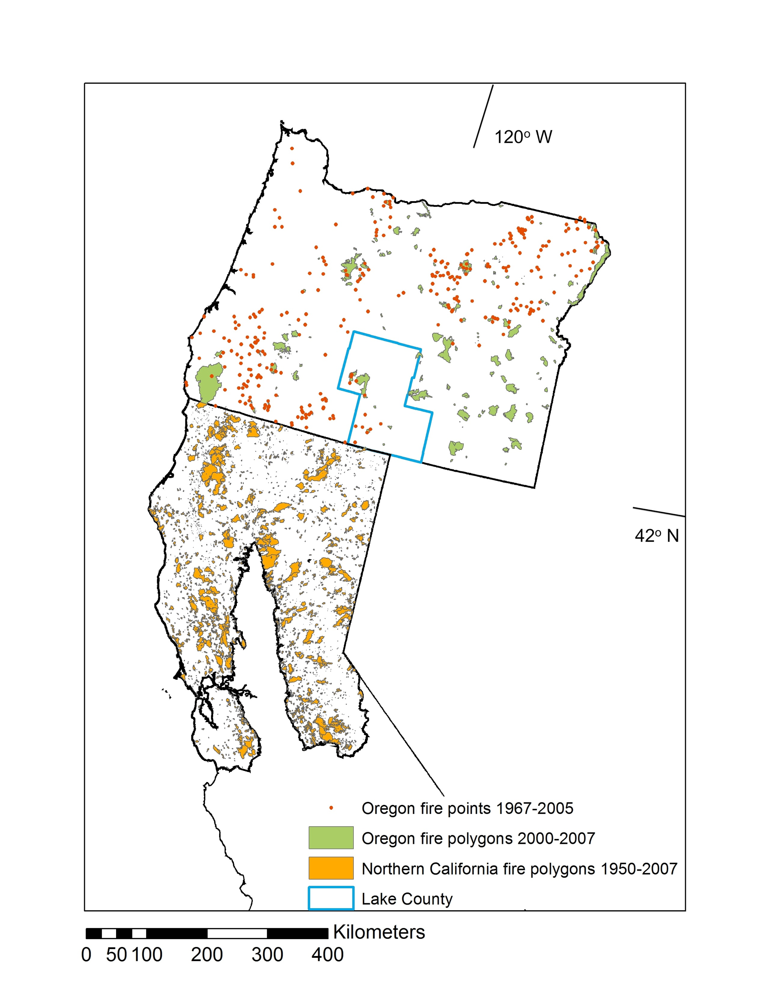
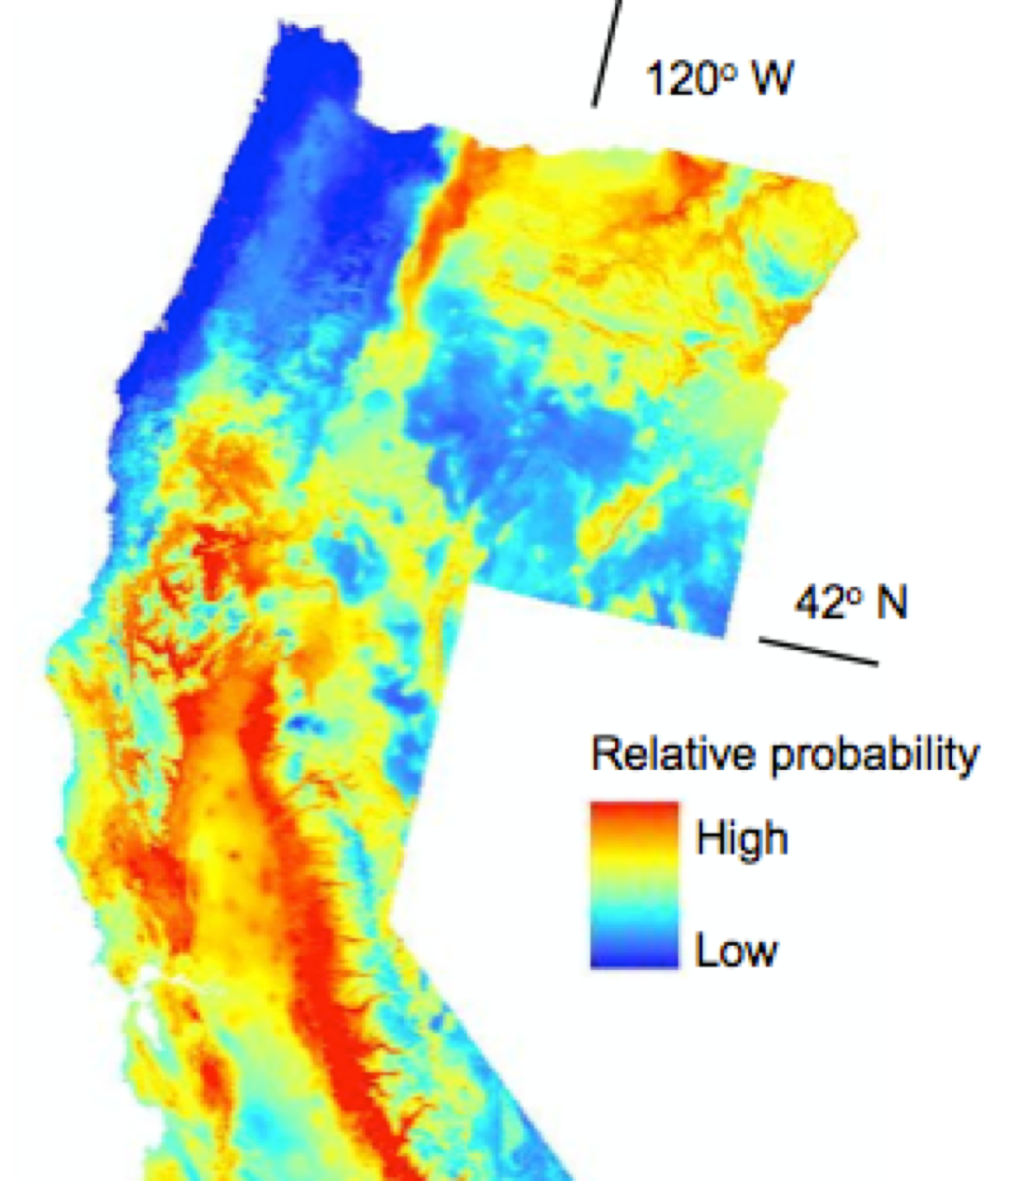
Newman, Waller and Moritz, manuscript

Slide 9
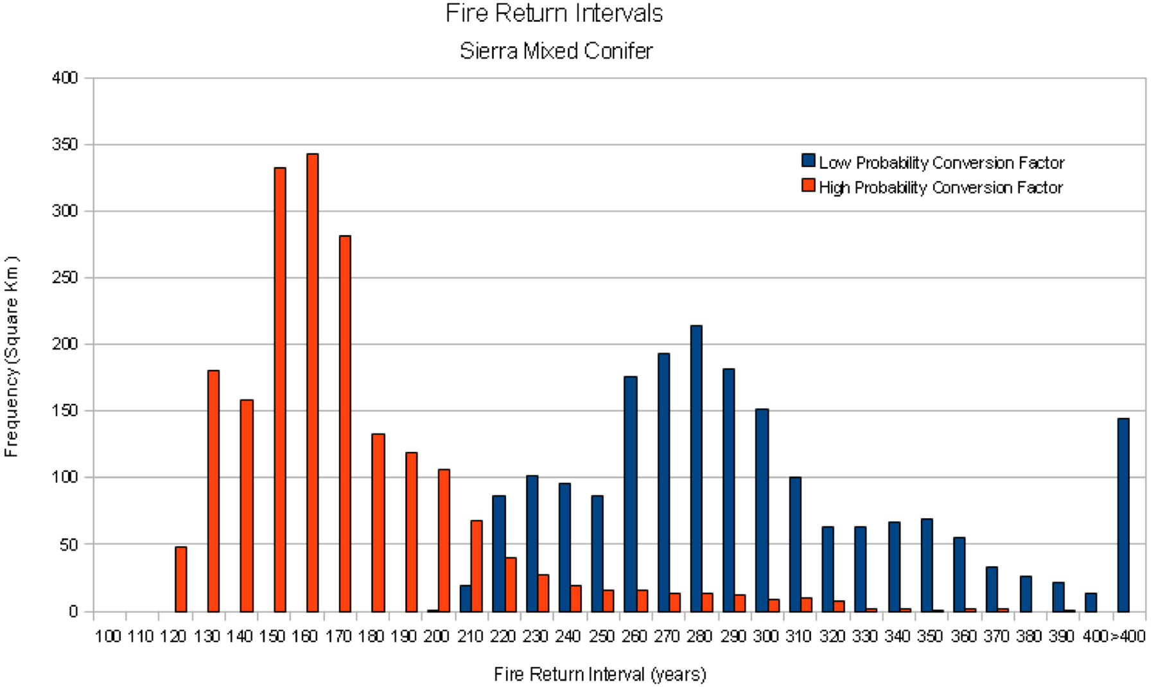
Choice of spatial and temporal scales greatly affect predictions
Fire Return Intervals
Sierra Mixed Conifer
Low probability conversion factor
High probability conversion factor
Frequency (square km)
Fire Return Interval (years)

Slide 10
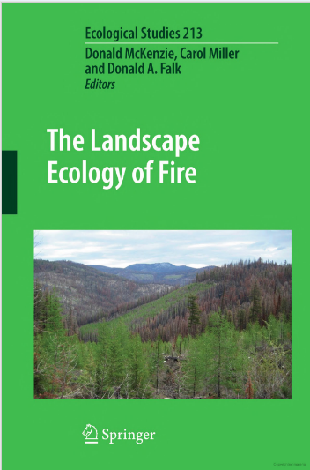
The Energy, Resistance and Scale Framework
Fires-- from ignitions to fire regimes-- can be modeled as energy (resources to consume), resistance to that consumption, and scale of effects.
(2011)

Slide 11
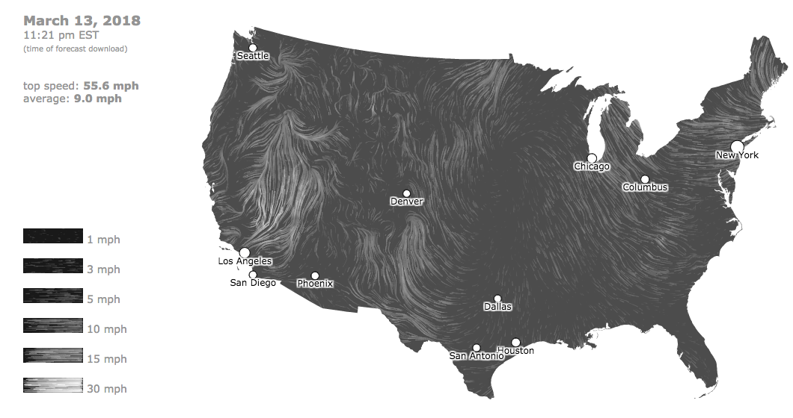
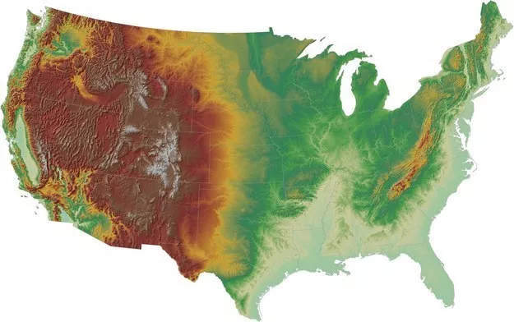
Resistance Scale
Dynamic maps from:
hint.fm/wind
The State Space Compression Framework may provide a better method for “coarse-graining” (going from microstates to macrostates)
than default MaxEnt models
Wolpert, D.H., Grochow, J.A., Libby, E. and DeDeo, S. (2014)
Optimal high-level descriptions of dynamical systems. arXiv preprint arXiv:1409.7403
What about Energy?
Resistance might be better modeled by a higher rank tensor field plus some scalar fields

Slide 12
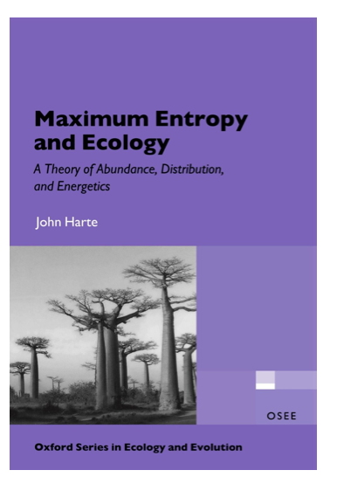
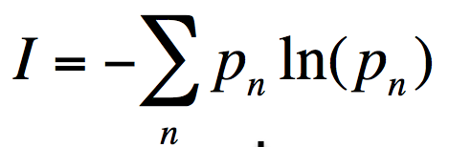
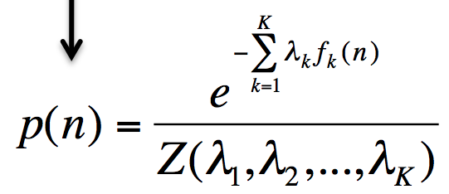
The Maximum Entropy Theory of Ecology (METE)
Method of
Lagrange multipliers
State Variables
A: Area
S: number of Species
N: Number of individuals
E: total Energy
Solve for p_{n}’s and also, the
least-biased distribution given the constraints
(Jaynes 1979;1982)
Applying to state variables A,S,N, and E
results in METE’s “Ecosystem Structure Function”
R(n, ε)
Harte, Zillio, Conlisk, and Smith (2008) Ecology
Harte (2011)

Slide 13

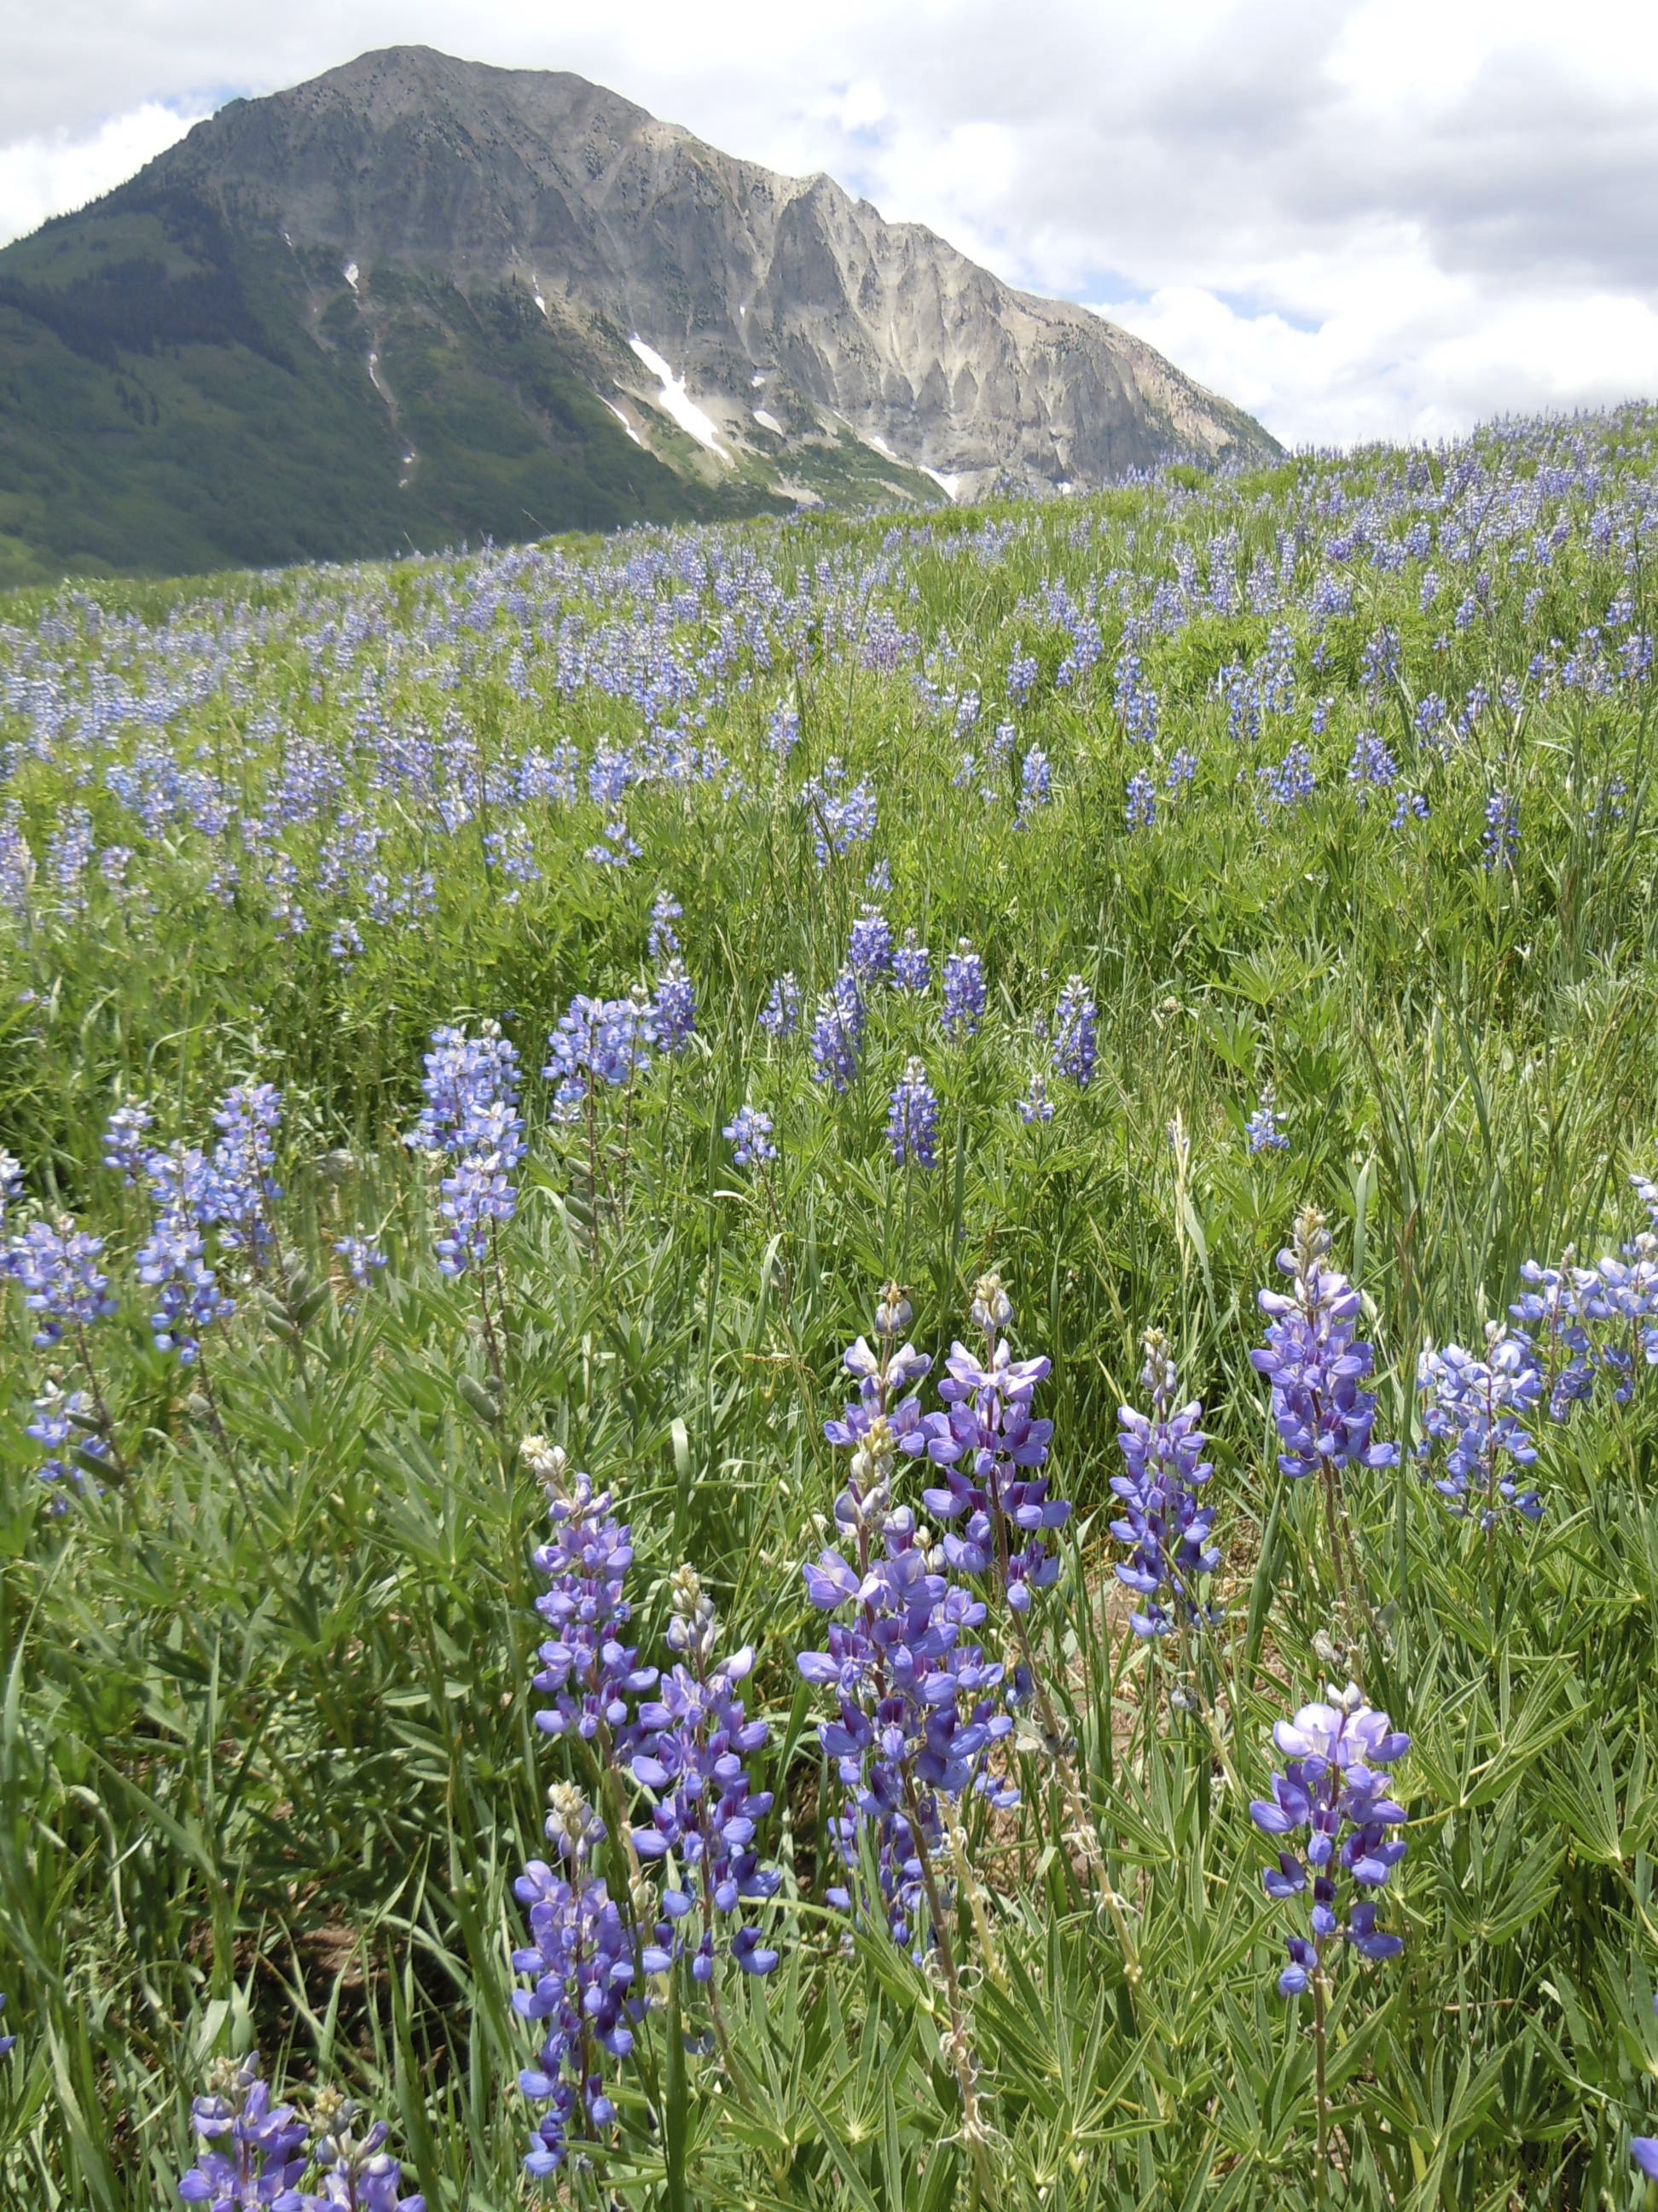

Testing metabolic rate distributions

Slide 14
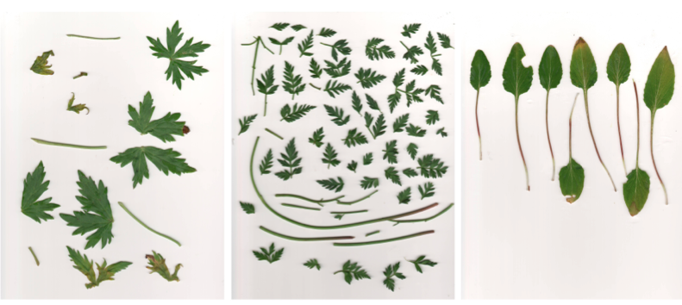
Image processing:
Measuring leaf area to determine metabolic energy

Slide 15
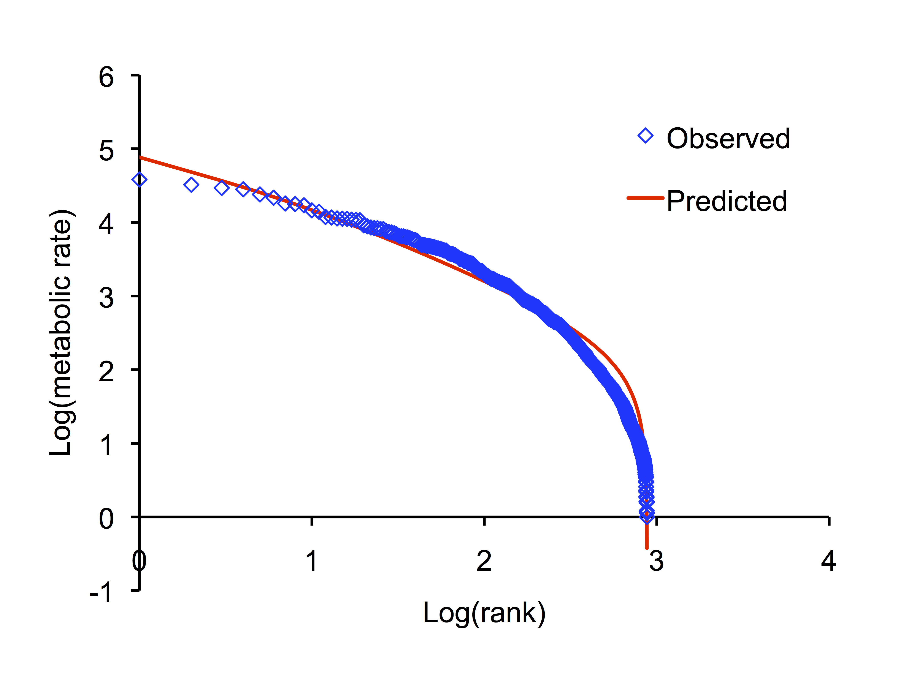
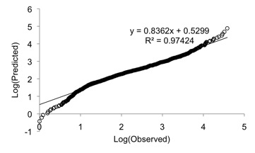


Individual Energy Distribution (IED)
a community-level metric
Adapted from Newman et al. (2014) Ecology

Slide 16
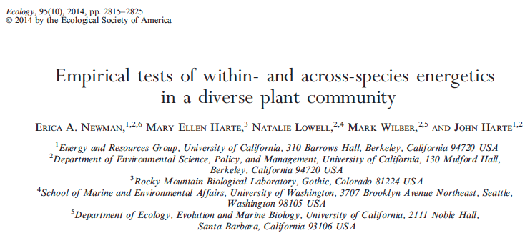
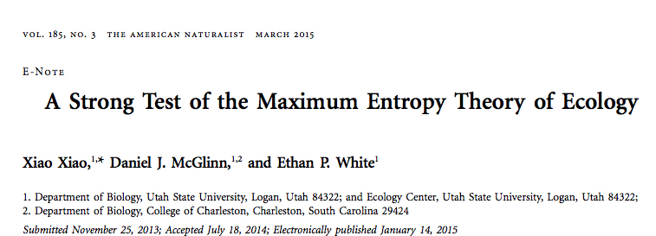
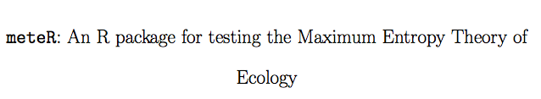
Newman et al. (2014) Ecology
Harte (2011)
Xiao et al. (2015) American Naturalist
Rominger and Merow (2016) Methods in Ecology and Evolution

Slide 17
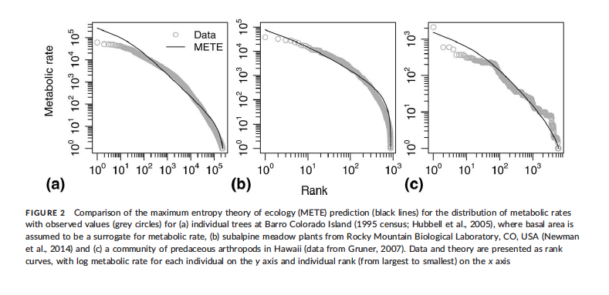
Individual Energy Distribution (IED)
a community-level metric
Harte, Newman and Rominger (2017) Global Ecology and Biogeography

Slide 18
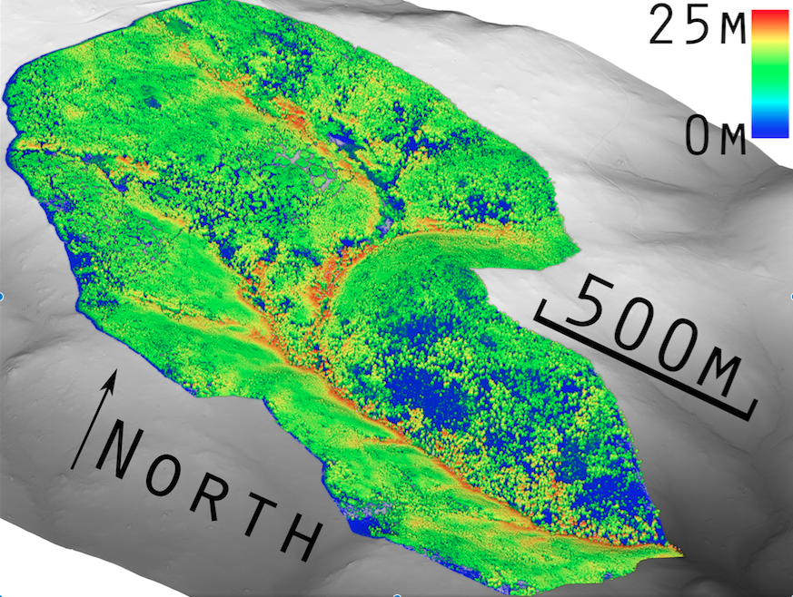
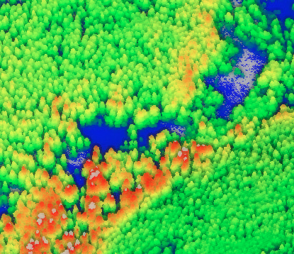
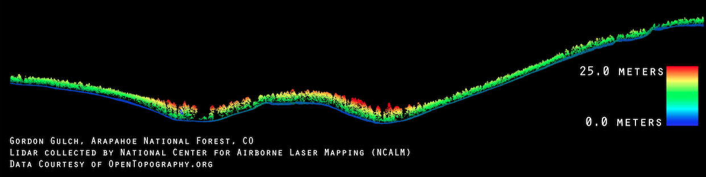

Slide 19
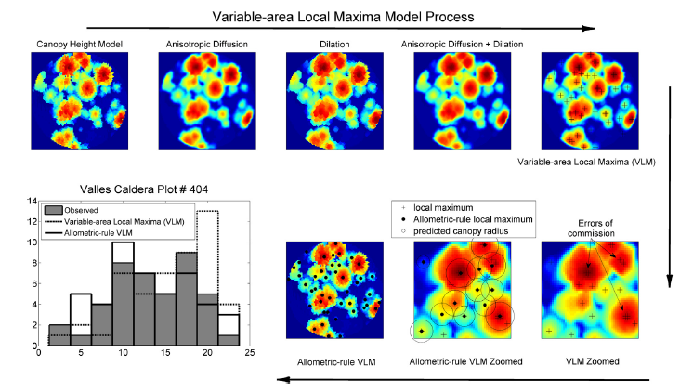
LiDAR detection algorithms can now
detect live individuals
TL Swetnam and DA Falk (2014) Forest Ecology and Management

Slide 20
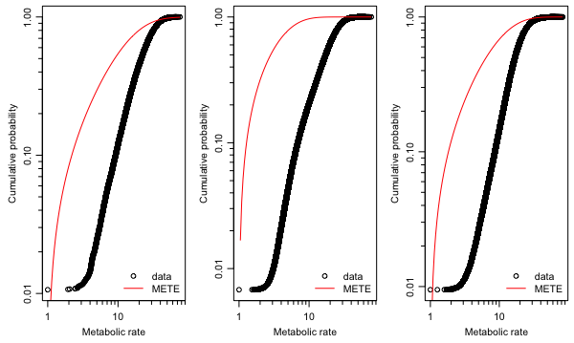
Extending METE’s energetics predictions to the landscape scale
(A) Betasso
(B) Como Creek
(C) Gordon Gulch

Slide 21

Conclusions
MaxEnt methods have been successfully applied to ecological questions
examples: MaxEnt software,
Maximum Information Entropy Theory of Ecology
Energy is the common element in questions about biodiversity patterns and fire regimes
Alternate approaches to what observable variables are included in fire regime models can make use of Energy as a uniting currency between landscape ecology and macroecology
Acknowledgements
University of Arizona/USDA Forest Service
Don Falk, Don McKenzie, Tyson Swetnam, Brian Maitner
Funding
USDA Forest Service
Follow me on Twitter:
@eanewmanecology

Slide 22
A,S,N,E
Ecosystem structure function
[method of Lagrange
multipliers]
[sum over n
of n*R]
[integrating over ε]
Distribution of energy
over all individuals in
area A₀ (IED)
Species Abundance
Distribution (SAD)
Species-level spatial
abundance distribution
[sum over n₀ of
]
Species-level energy
distributions (SEDs)
Occupancy-abundance
relationship: Fraction of occupied cells =
n₀/(n₀ + number of cells)
Endemics-Area Relationship (EAR)
[sum over n₀ of
[taking the means]
Species-Area Relationship (SAR)
(leads to universal scale collapse)
Average Species
Energy Distribution
Adapted from: Harte and Newman (2014) Trends in Ecology & Evolution

